Slide 1
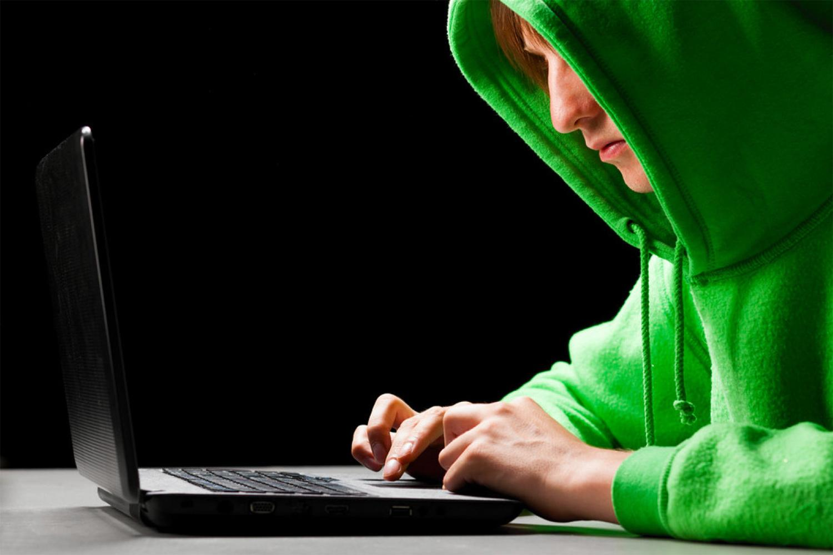
Security Risks Information
By Maison Roberts

Slide 2
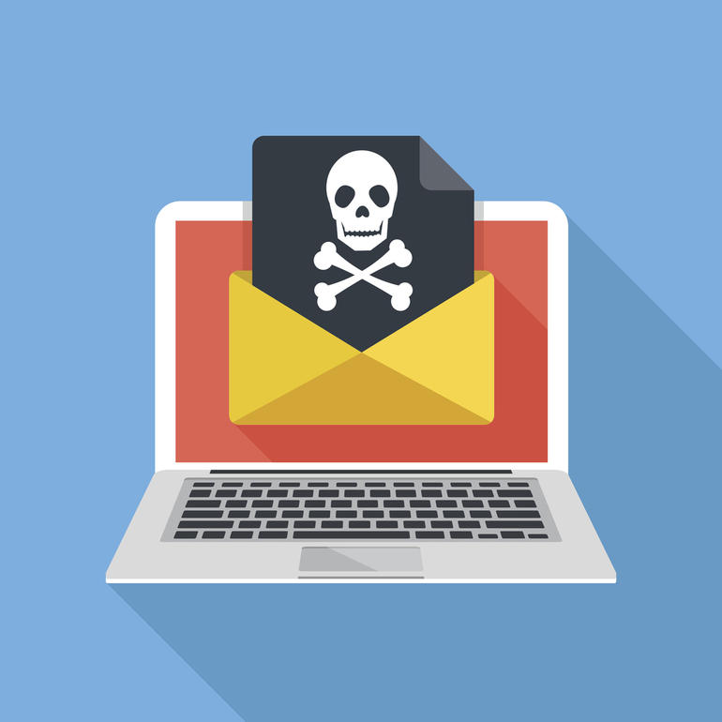
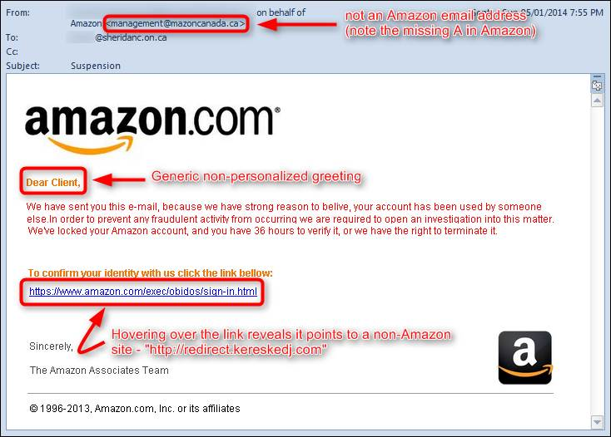
Email Threats
Spam Mail is when someone continually sends
Emails that has Malware or Random things which can potentially install a virus on your pc
Phishing scams reel you in by pretending to be someone else like this:

Slide 3
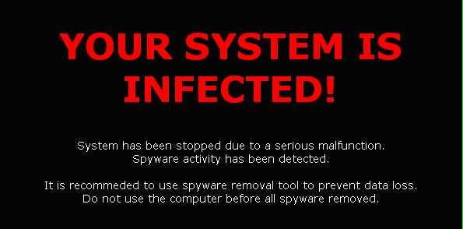
Viruses
There are different types of viruses like Trojan Horse, Spyware, Adware and Worms
Some programs you should never download are: BonziBuddy, WannaCry 2.0 and Memz

Slide 4
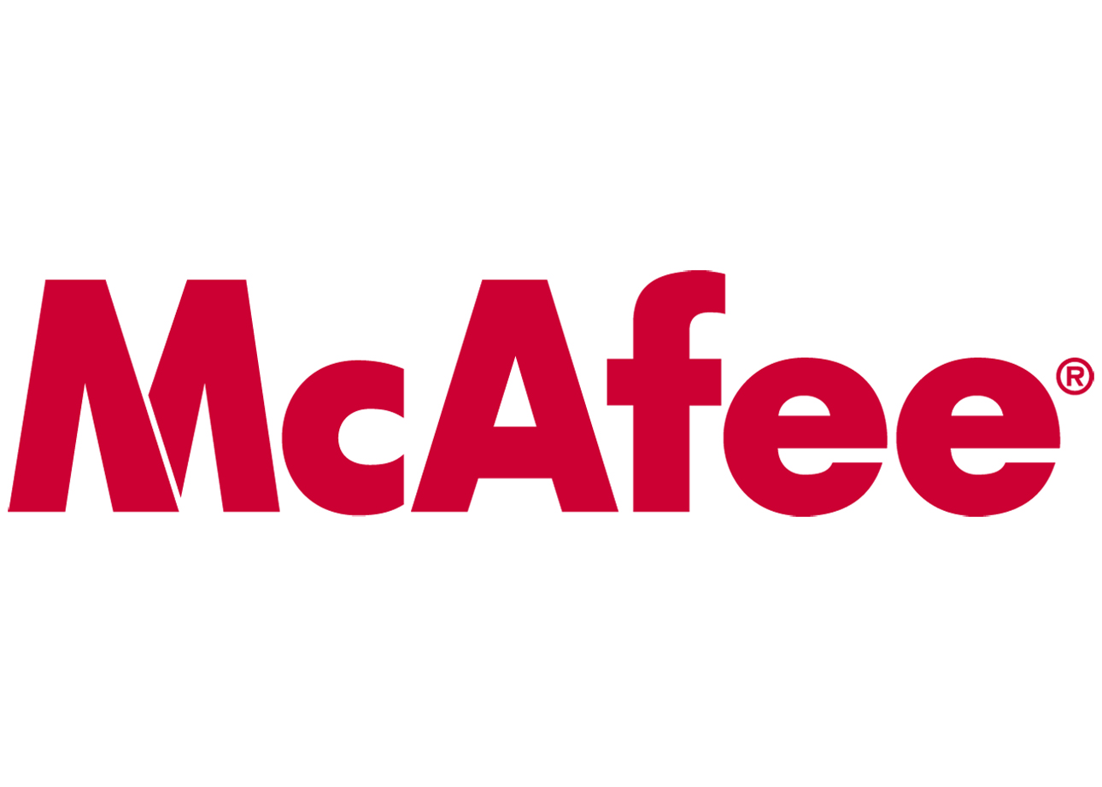

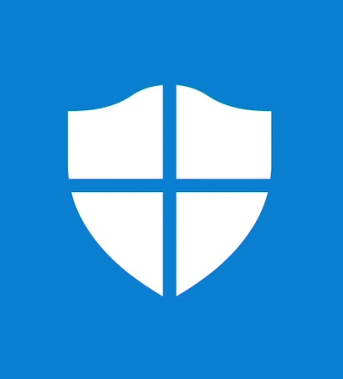
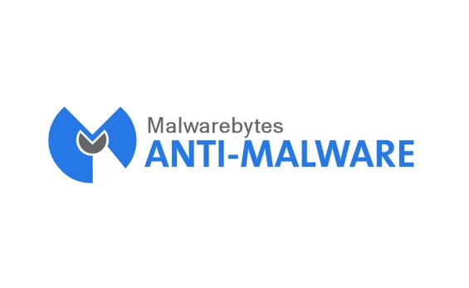

Antivirus Software
There are a lot of different antivirus software's like: Malwarebytes Windows Defender Avast Antivirus and More… They Protect your pc from viruses to attack the users data bank details Information about you.

Slide 5
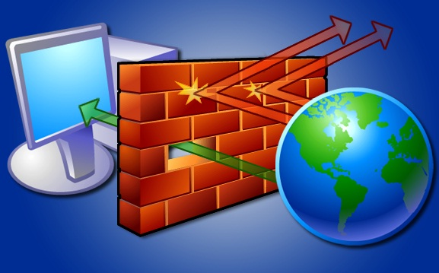
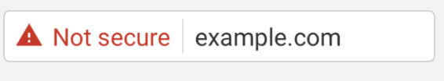
Firewalls
Firewalls it doesn’t let in threats and viruses from the internet infect you say you on a
It could download viruses from that website that some one has set up to trick you.

Slide 6
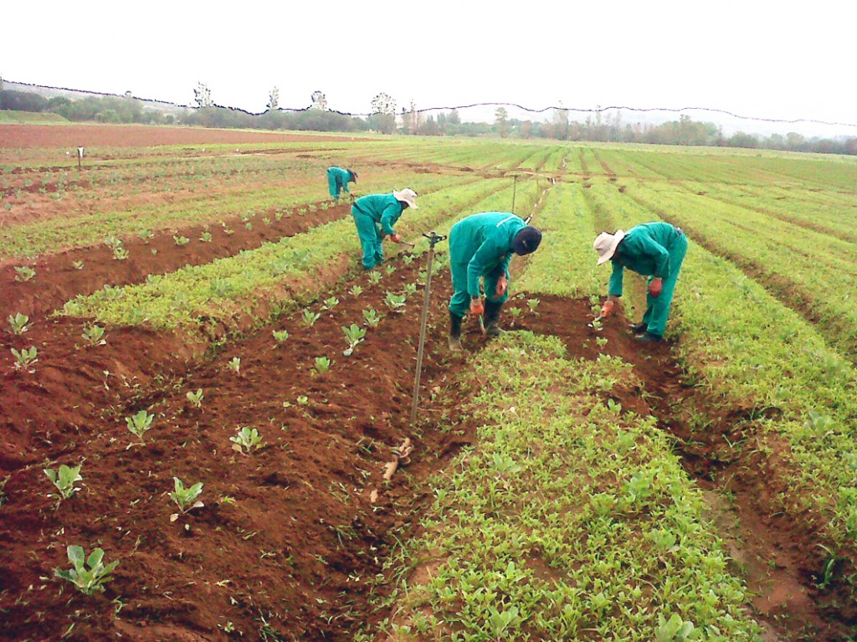
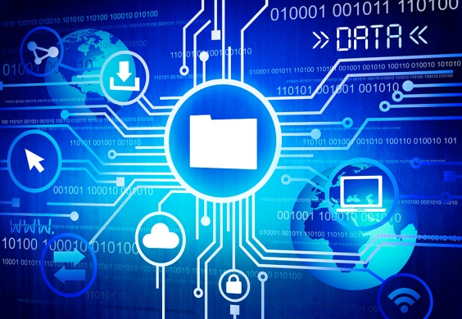

Pharming
Pharming is when some one pretends to be you eg they call your bank and pretends to be you and steals your money they are saying they are you

Slide 7
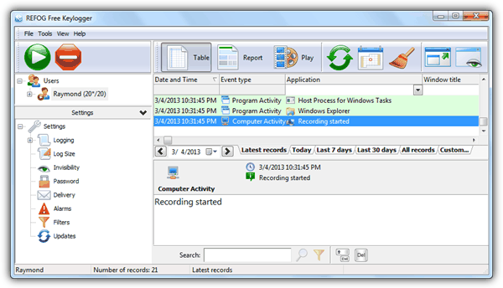
Key Logger
A key logger is when someone recordes all the things you type like passwords and all the messages you send

Slide 8
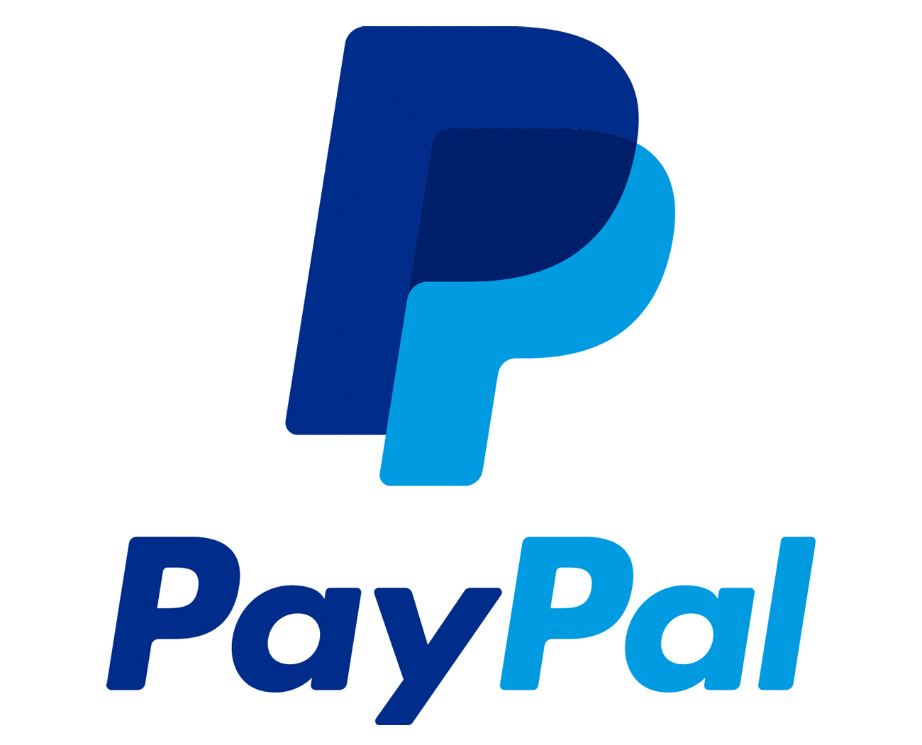
Secure Payment Systems
A payment system is any system used to settle financial transactions through the transfer of monetary value, and includes the institutions, instruments, people, rules, procedures, standards, and technologies that make such an exchange possible. A common type of payment system is the operational network that links bank accounts and provides for monetary exchange using bank deposits.

